Slide 1


Slide 2


COMPANY BANKRUPTCY PREDICTION

Slide 3
Business problem
As bankruptcy due to business failure can negatively affect the enterprise as well as the global economy, it is crucial to understand and predict whether a company is showing symptoms of getting bankrupt or not. The idea is to analyze the distresses in the corporate by taking into considerations different KPI’s of the company. These distresses often lead to bankruptcy of the company if not alerted at the right time.
The problem statement is to develop a prediction model which will predict whether a company can go bankrupt or not. This will help the company to take appropriate decisions.
Why is it necessary?
Bankruptcy prediction is an important problem in finance, since successful predictions would allow stakeholders to take early actions to limit their economic losses.
An accurate bankruptcy prediction can not only reduce banks’ loan default losses, but also improve their operating efficiency (namely reduce the phenomenon that misjudge clients’ bankruptcy risk and thus refuse to grant credit) and ensure the stability of the financial system, effective bankruptcy prediction becomes a valued research issue in bank loan practices.
Also this is advantageous to Banks who can prevent losses by avoiding loan to these companies.
The objective of this Capstone Project is to create a model for predicting potential bankruptcy of companies using suitable classification methods, and to evaluate the results of the methods used.

Slide 4
Dataset
The data is collected from Taiwan Economic Journal for the years 1999 to 2009. Company bankruptcy was defined based on the business regulations of the Taiwan Stock Exchange. The dataset consists of multiple financial ratio features such as:
Return on Assets (ROAs),Gross Profits, Cash flows, Taxes, Growth rate, Debt, Turnover, Revenue, Liability, Operating & Net income and Expenses, etc.
This dataset is highly imbalanced. It makes this problem very challenging to generalize well for final predictions.
There are total 6819 samples in dataset and 96 features (including class label).
Out of 6819, 6599 are negative class and only 220 are positive class.

Slide 5
Flow of Solving the Problem
Exploratory data analysis
Removing muticollinearity
Removing the outliers
Reducing Skewness
Oversampling the target feature using SMOTE
Feature selection
Scaling the features using standard scaler
Building the Machine Learning model by using suitable classification algorithms
Comparing the results of the models implemented & evaluation metrics

Slide 6
Exploratory Data Analysis
The dataset Contains:
6819 rows and 96 features
It has no duplicate values and missing values.
‘Bankrupt?’ is a dependent feature.
Dependent variable contains 6599 - 0s and 220 - 1s.
Through data.info(), we observed that we have a majority of data types of columns as"float64" data.
The categorical data is distinguished as binary 1 and 0, thus stored as "int64".
Separated the numeric and categorical data to analyze the dataset. Since, there are only three categorical data columns, we will explore these columns first.

Slide 7
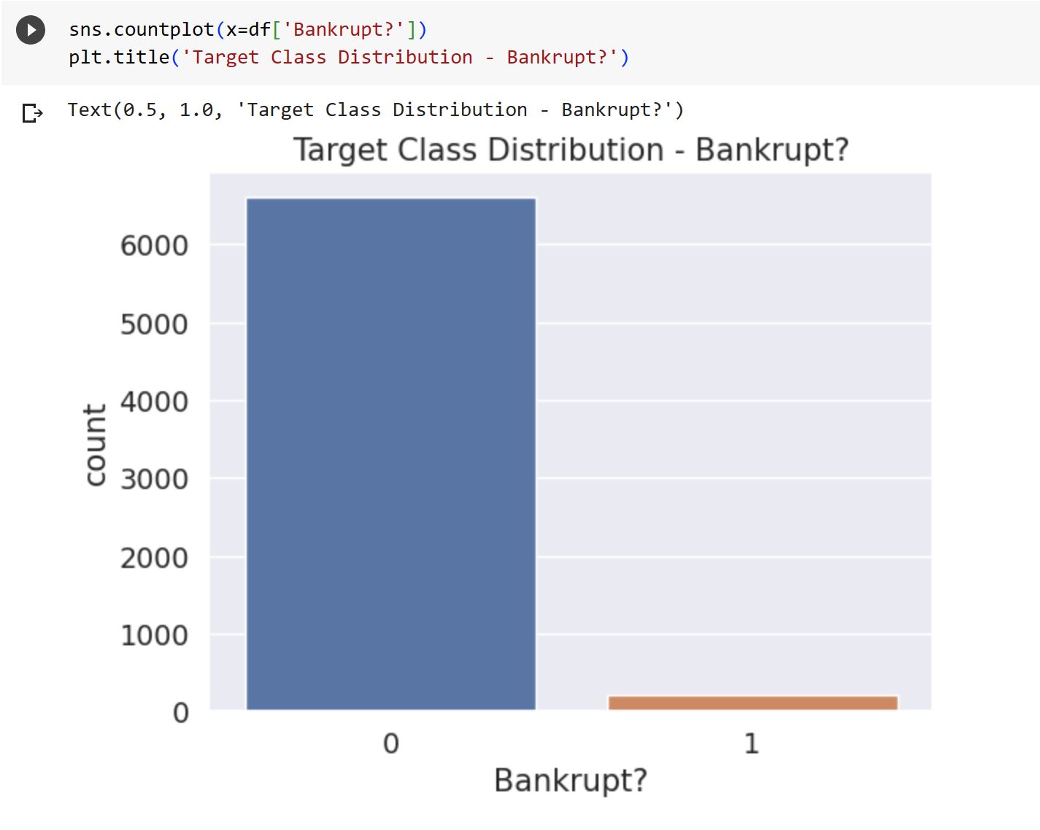
Target Class Distribution
The company which are bankrupted are very less compared to non bankrupt companies.
Companies that did not go bankrupt: 96.8 % of whole data set
Companies that went bankrupt: 3.2 % of whole data set
There is an imbalance in the dataset.
we need to use oversampling method to correct it.
Otherwise the model will be biased towards the majority class & would just predict every company as not bankrupt.
This is the main obstacle that we need to solve to obtain good performance.

Slide 8
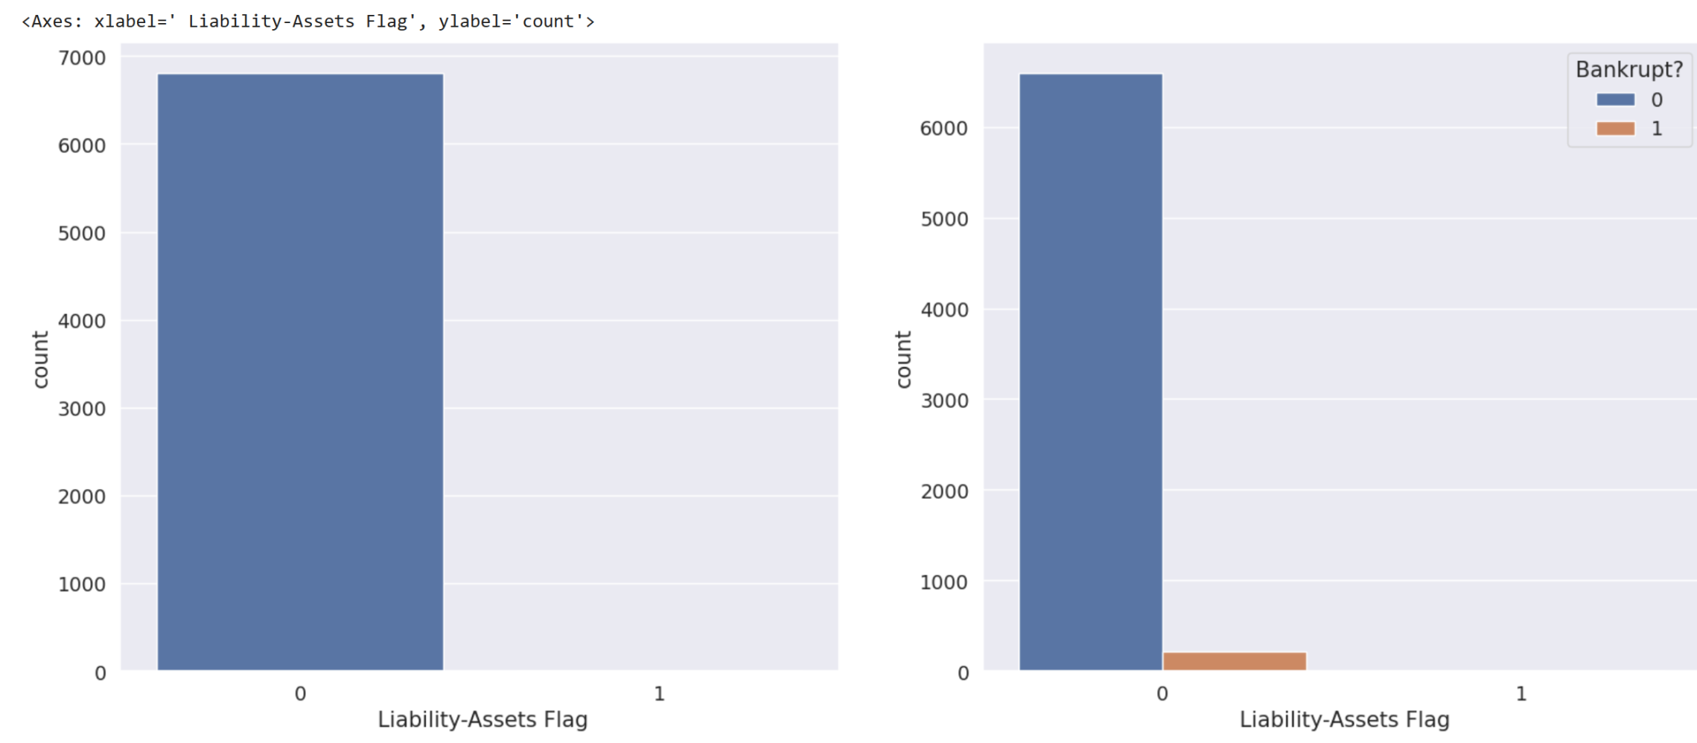
Liability Assets Flag
A small portion of organizations suffers bankruptcy, although possessing more assets than their liabilities.
In comparison, more companies go bankrupt with fewer assets than liabilities.

Slide 9
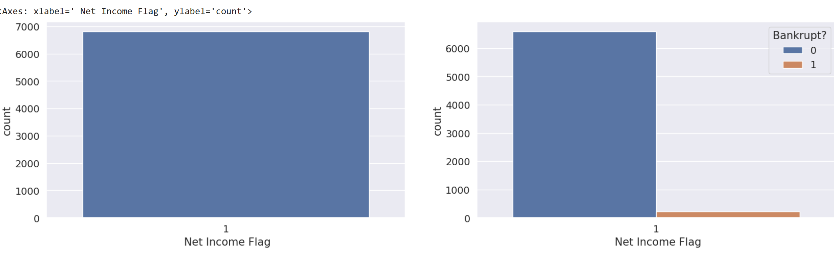
Net Income Flag
The "Net Income" flag denotes the status of an organization's income in the last two years, where if the net income is negative for the past two years, the flagged value will be 1, else the value is 0. We observe that all the records have been exhibiting a loss for the past two years.
Many organizations that have suffered losses for the past two years have stabilized their business, thus avoiding bankruptcy.

Slide 10
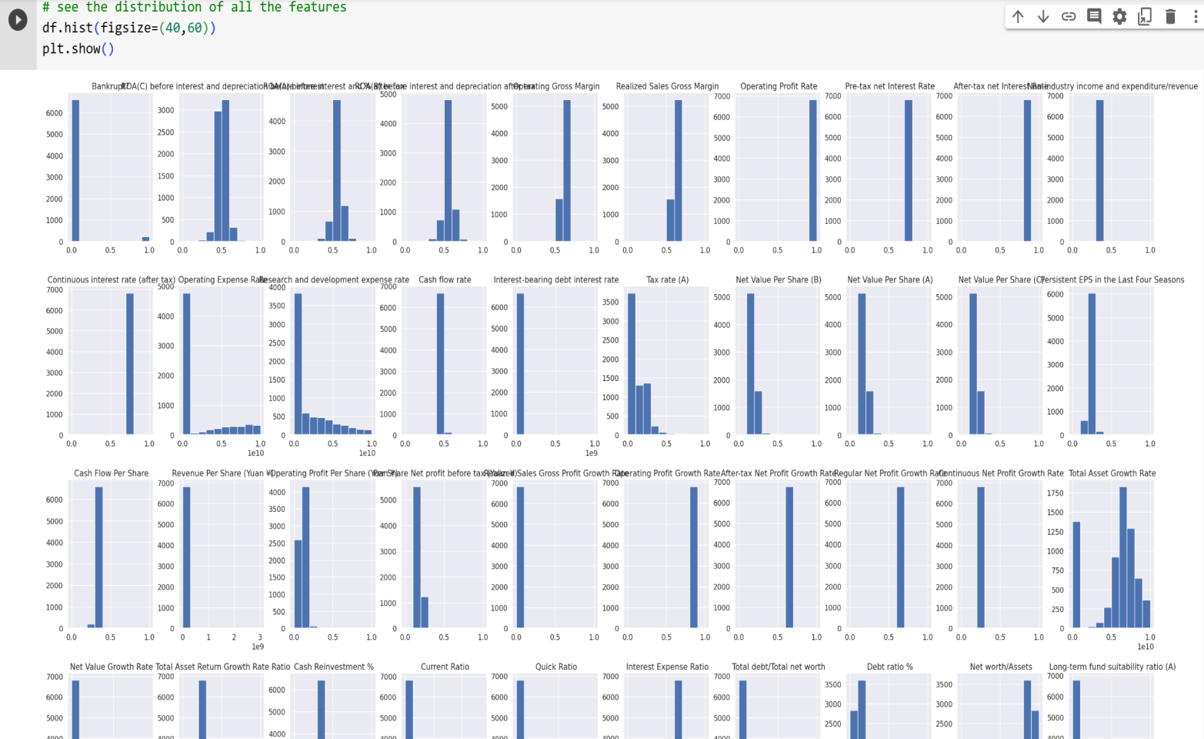
Distribution of features
If we observe carefully most of the columns are skewed. This means many of the data points lie towards it's minimum or maximum.
For Example, Observe Operating Expense Rate and Research and development expense rate.
This means model will not be able distinguish well between yes and no as most value lie towards one end.

Slide 11
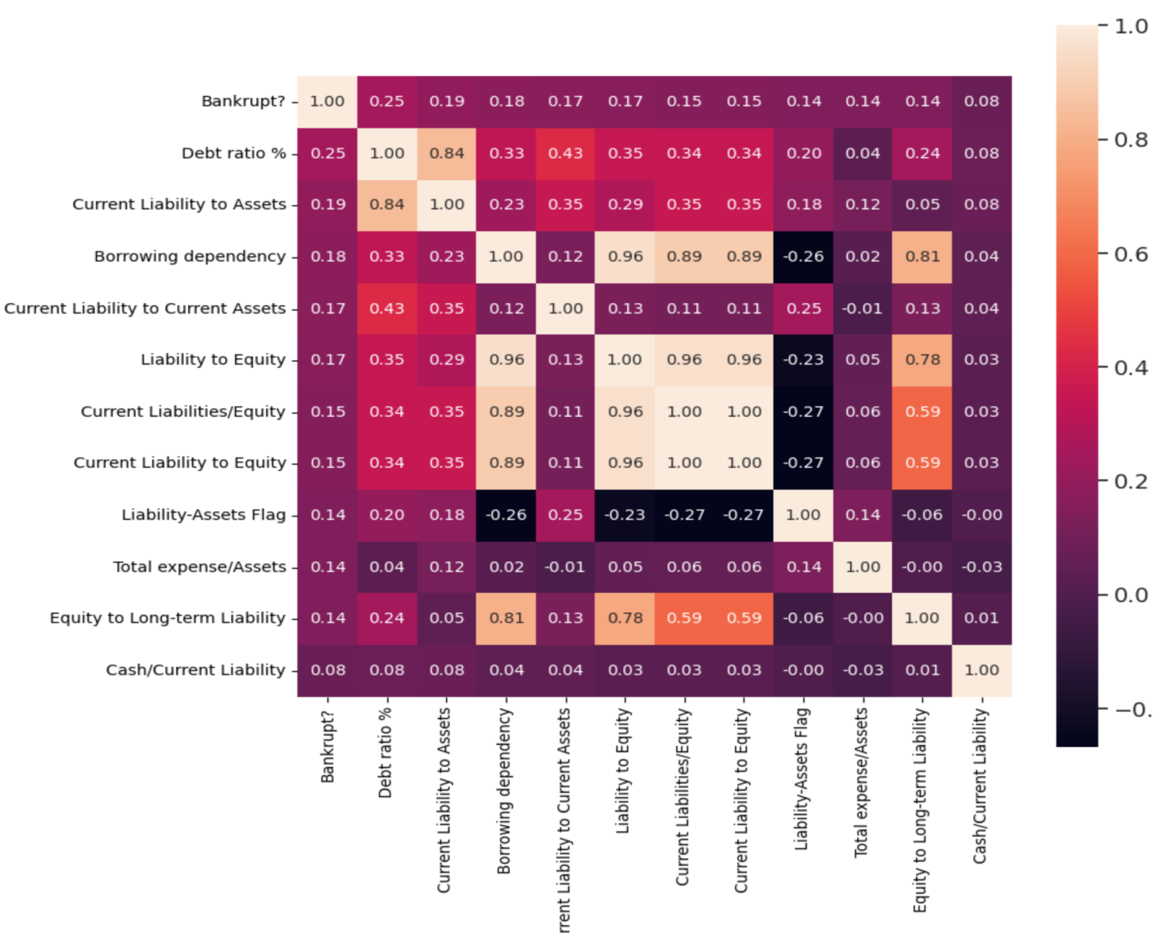
Correlation of Top 12 Independent Features with Target Variable

Slide 12
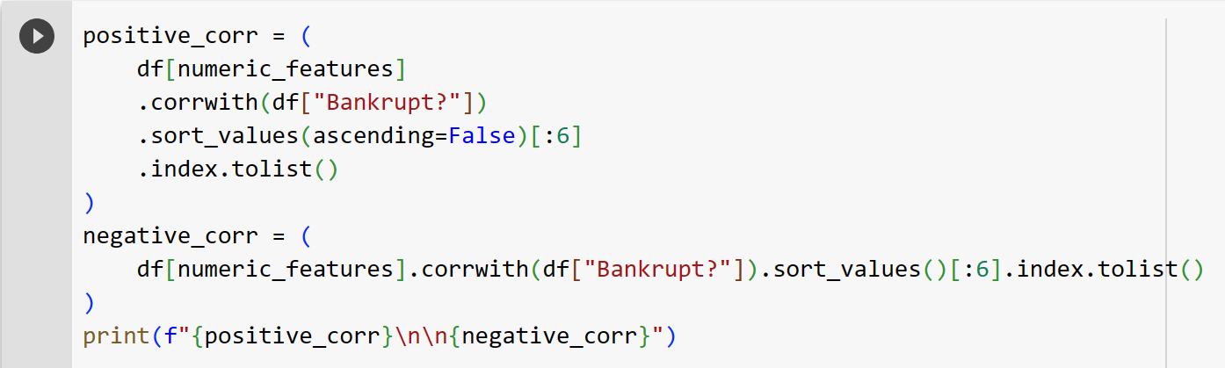
Focusing On Top 6 Positive & Negatively Correlated Features
Top 6 Positively Correlated Features
[Debt ratio %', ' Current Liability to Assets', ' Borrowing dependency', ' Current Liability to Current Assets', ' Current Liabilities/Equity', ' Total expense/Assets']
Top 6 Negatively Correlated Features
[' ROA(C) before interest and depreciation before interest', ' Persistent EPS in the Last Four Seasons', ' Retained Earnings to Total Assets', ' Working Capital to Total Assets', " Net Income to Stockholder's Equity", ' Net Value Per Share (B)']

Slide 13
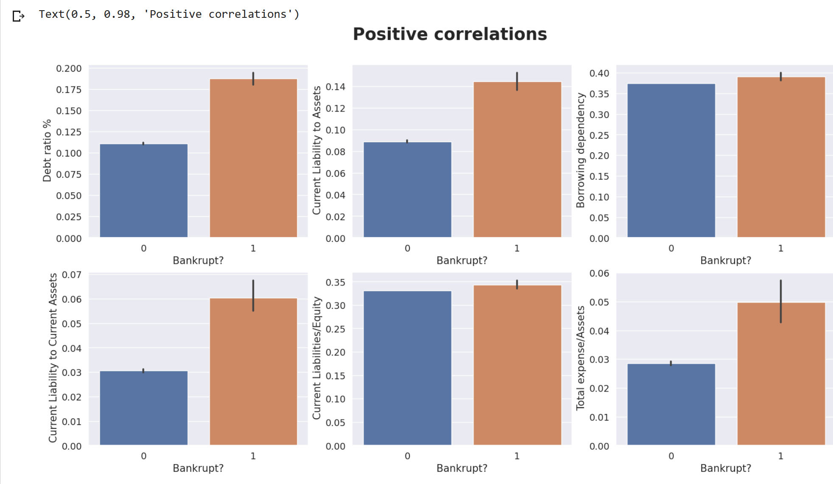
Positive Correlation
We can see that for bankrupt companies Debt %, Current Liabilities to Assets and Current Liabilities to Current Assets have high values

Slide 14
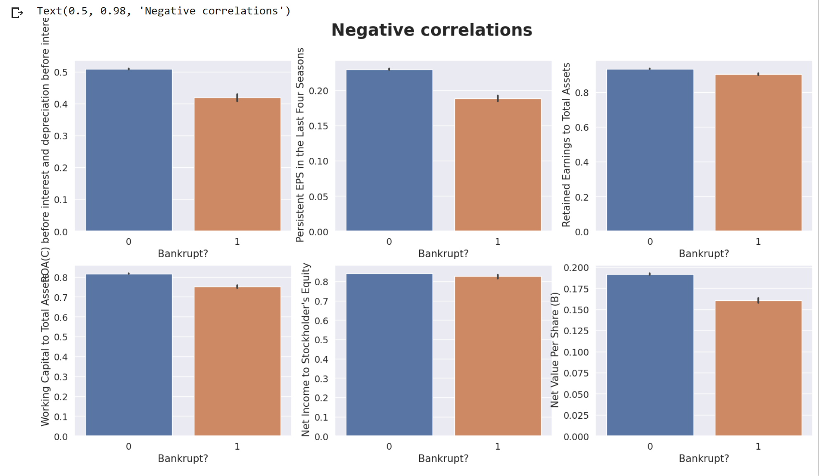
Negative Correlation
The higher the assets and profits, the less likely the company is to go bankrupt
These attributes show us that the more the assets and earning of a company, the less likely is the organization to be bankrupt.

Slide 15
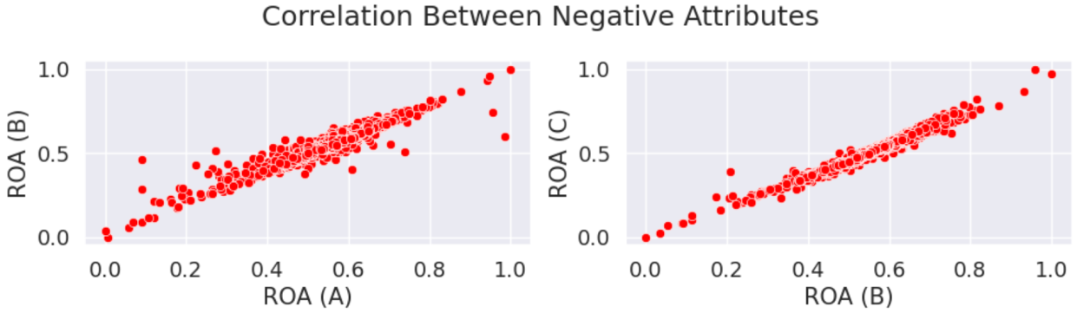
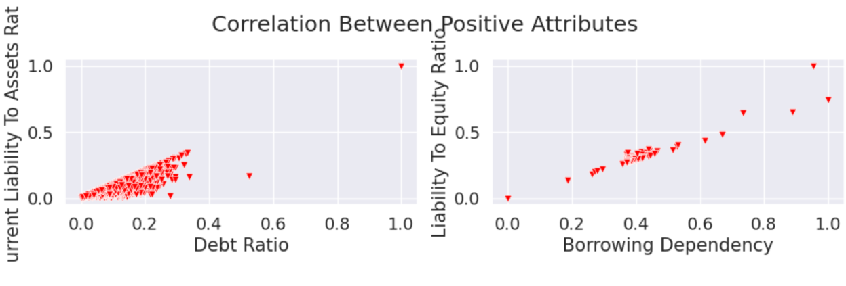
The relation of top 6 positive and negative correlation attributes among each other
There is a positive relation between attributes that have a low correlation with the target attribute
There is a positive relation between attributes that have a high correlation with the target attribute.

Slide 16
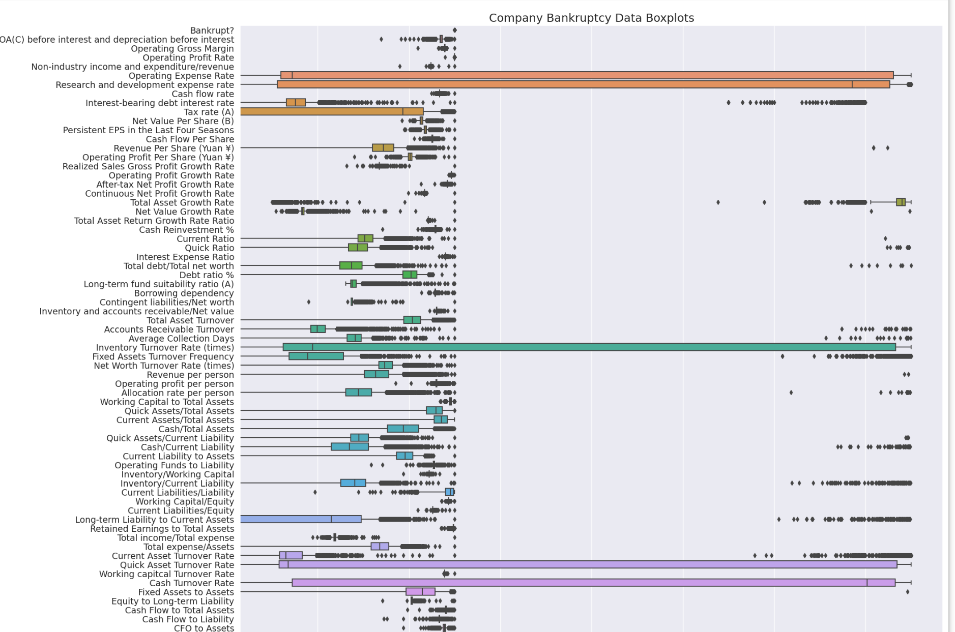
Outliers
There are multiple outliers in the dataset.

Slide 17
Summary Of Analysis
The number of organizations that have gone bankrupt in 10 years between 1999 – 2000 is few.
Several companies possess many assets, which is always a good sign for an organization. An organization cannot guarantee not being bankrupt, although owning several assets.
Net Income Flag plot showed us that most of the companies are running into Losses. Very few of the organizations that have had negative income in the past two years suffer from bankruptcy.
It is observed that “Debt Ratio %, Current Liability To Assets, Current Liability To Current Assets" attributes are a few of the attributes that have a high correlation with the target attribute.
An increase in the values of the attributes “Debt Ratio %, Current Liability To Assets, Current Liability To Current Assets” causes an organization to suffer heavy losses, thus resulting in bankruptcy.
An increase in the values of the attributes that have a negative correlation with the target attribute helps an organization avoid bankruptcy.

Slide 18
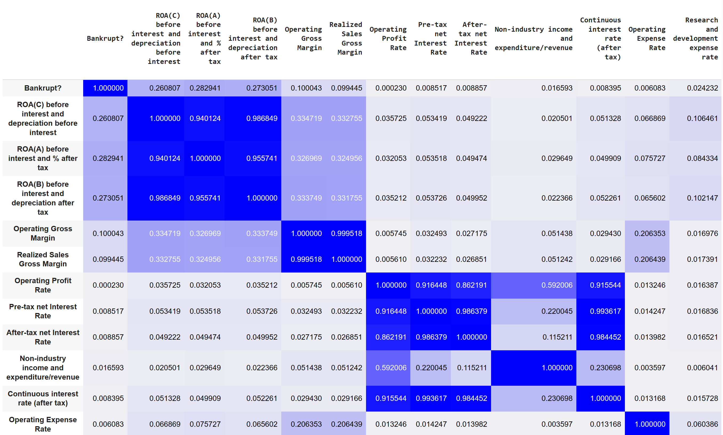
Multicollinearity
Found out columns whose correlation coefficient was greater than 0.9 and dropped them.
Total 19 columns were dropped.

Slide 19
Skeweness & Outliers
Skeweness in data
Skewness greater than 1 is corrected by using log.
where as skewness less than -1 is corrected using cube.
Outliers
Removed the outliers from the data by calculating the IQR.

Slide 20
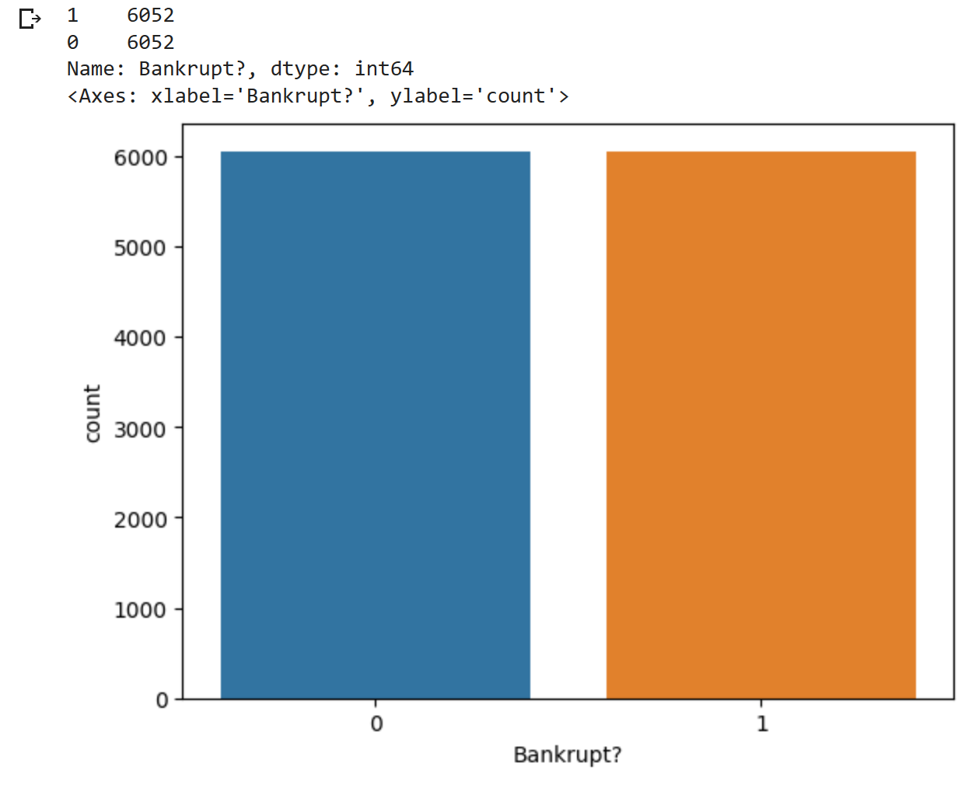
Oversampling the Target Feature
Created independent and dependent feature dataframes.
X=new_df.drop(labels=['Bankrupt?'], axis=1)
y=new_df['Bankrupt?']
The target feature is resampled using smote.

Slide 21
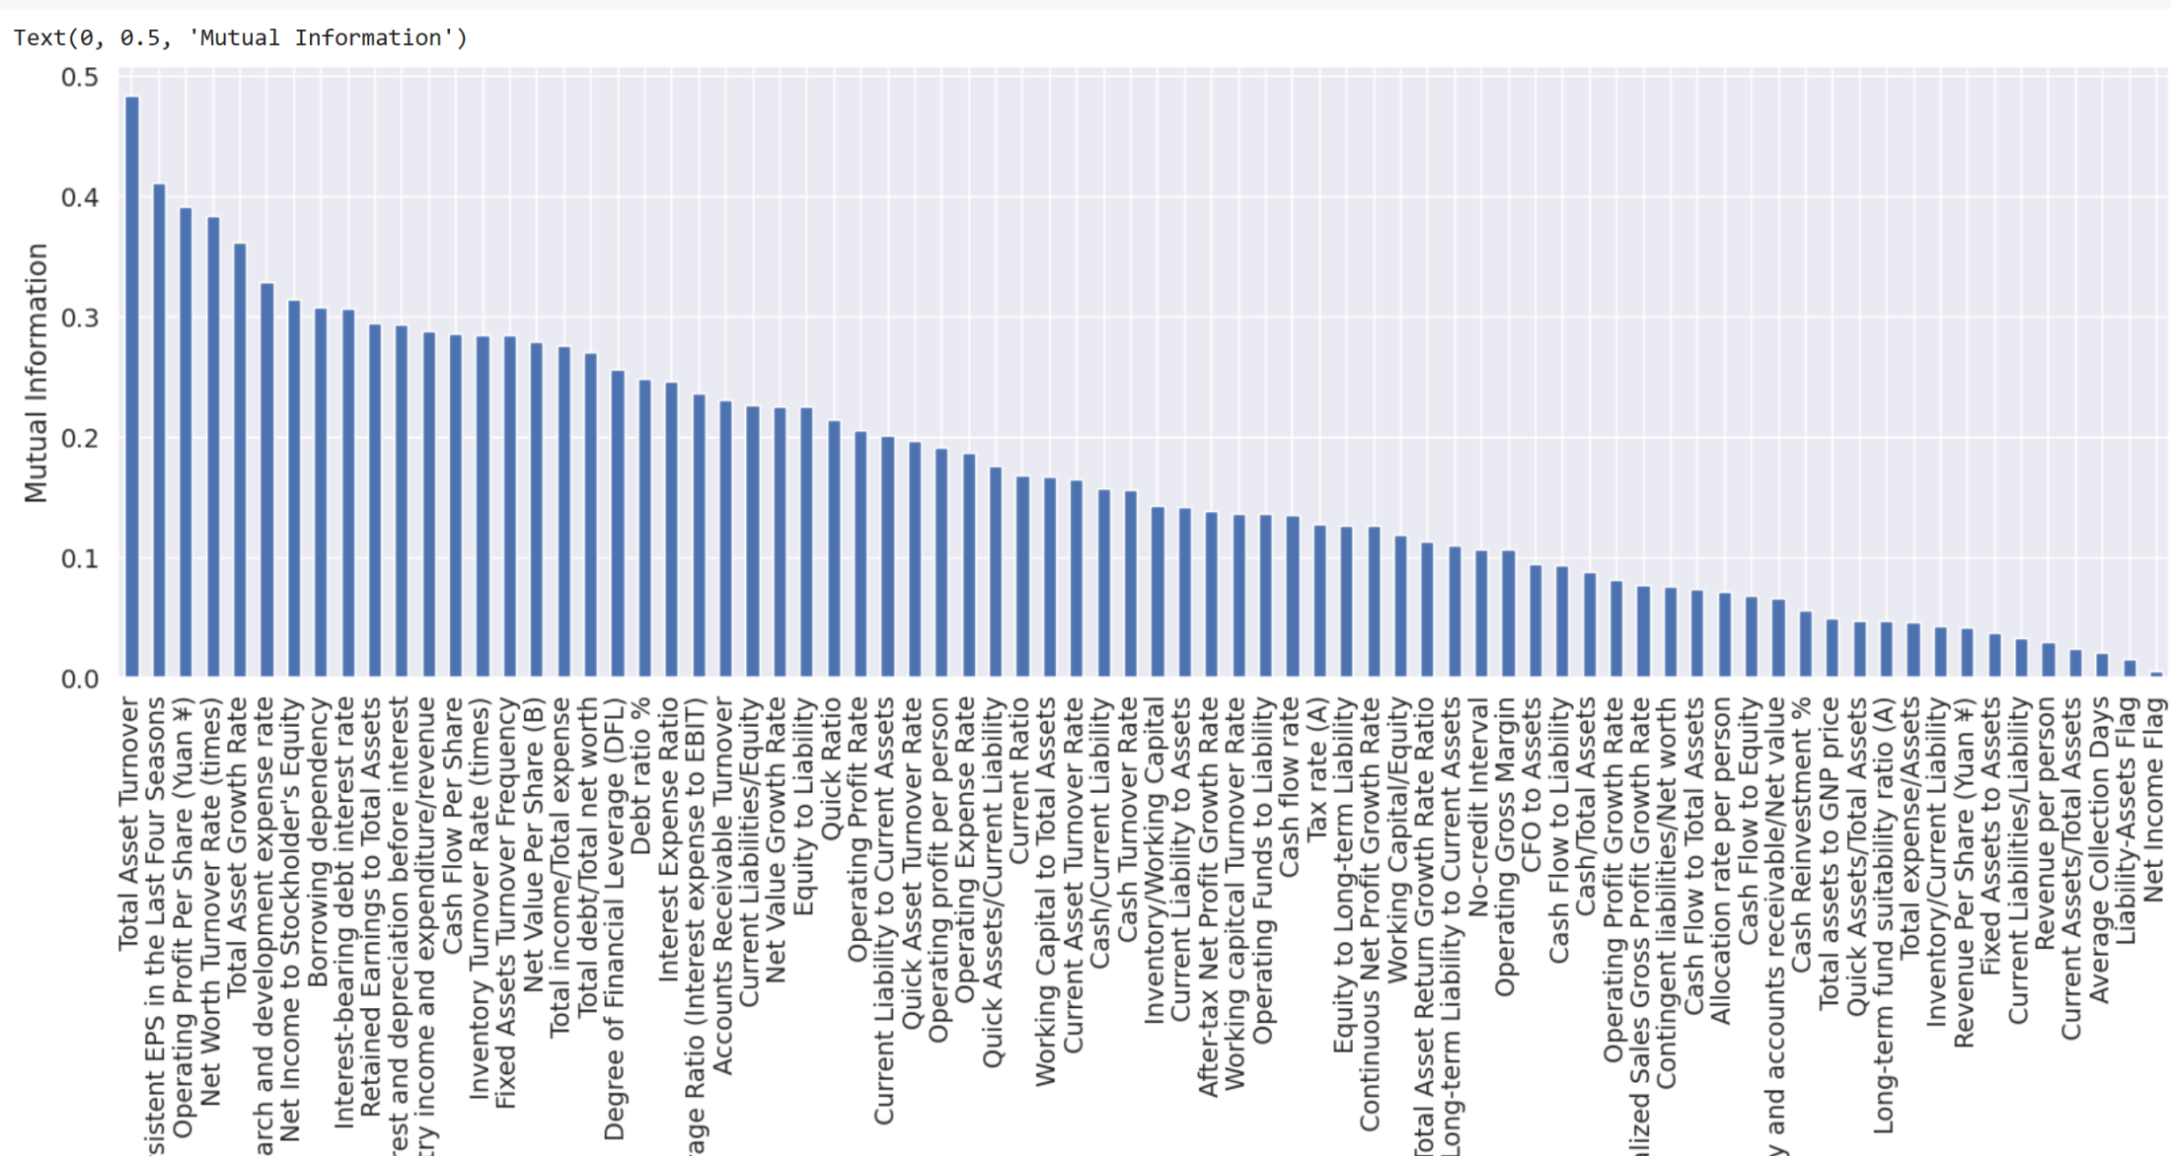
Feature Selection

Slide 22
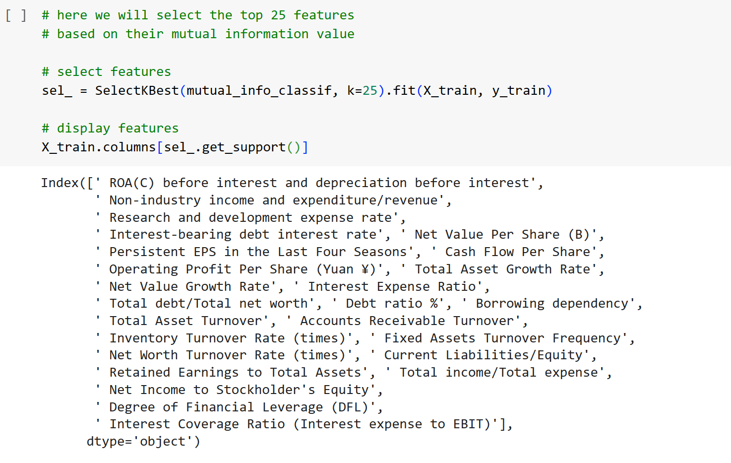
Feature Selection
Calculated the mutual information(mi) between the variables and the target the smaller the value of the mi, the less information we can infer from them.
Once we find the mutual information values, to select the features we need to determine a threshold, or cut-off value, above which a feature will be selected.
Selected the top 25 independent Features out of 96 Features.

Slide 23
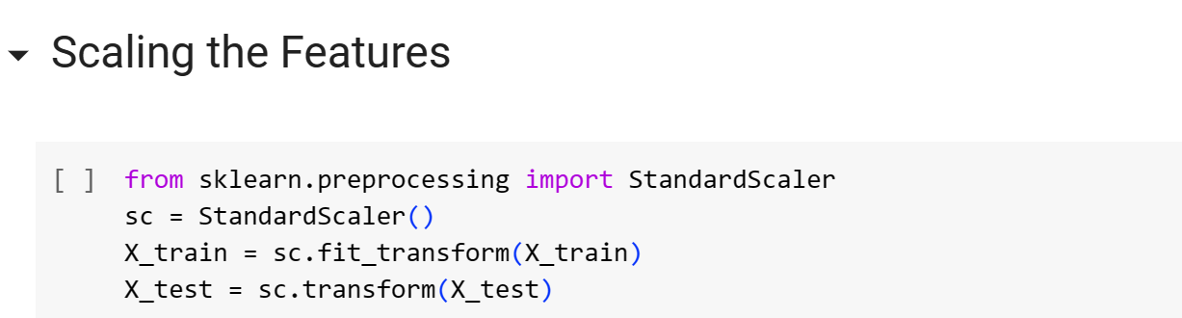
Modelling Approch
Splitting the dataset into training and testing sets (80% - 30%). We preserve the 30% testing set for the final evaluation.
Implemented 4 ML Model :
Logistic Regression
Random Forest
SVM
XGBoost

Slide 24
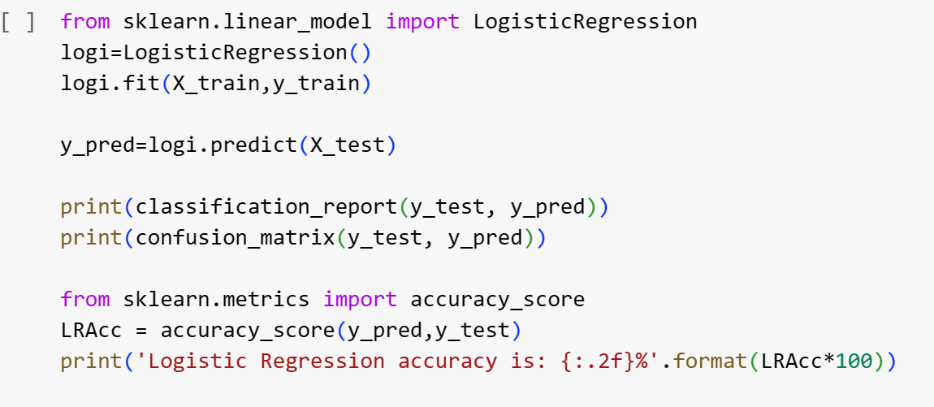
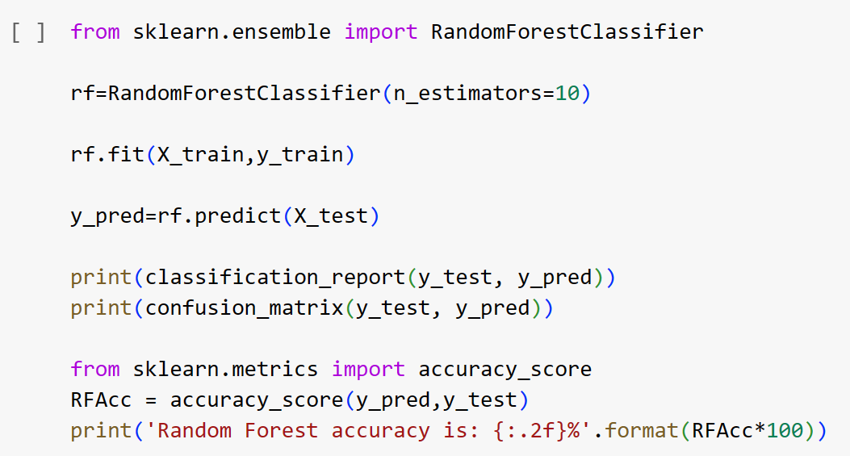
Machine Learning Models
Logistic Regression Model
Random Forest Model

Slide 25
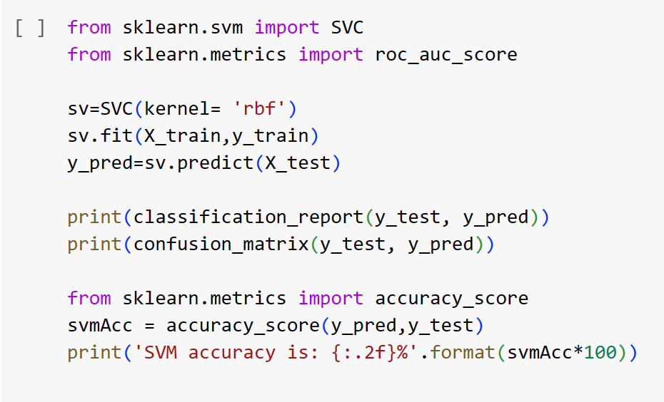
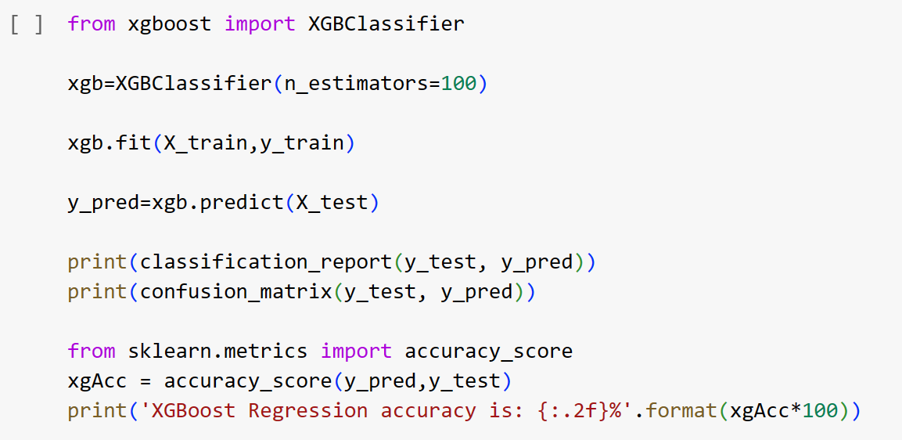
Machine Learning Models
SVM Model
XGBoost Model

Slide 26
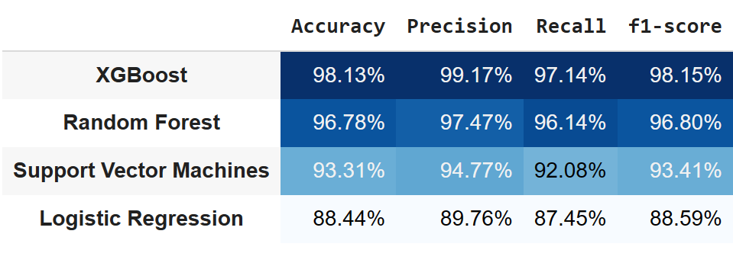
Comparing Different ML Models
Evaluation Metric
Since, in this problem it is important to predict the positive class with very high accuracy even if we are not able to predict the negative class.
To understand and compare model performances, accuracy is not a good choice of metrics here as this data is imbalanced. So I will be using Precision, F1 Score for evaluation.

Slide 27
Conclusion
Top 3 performing baseline models are XGBoost, Random forest & SVM.
The best performing model is XGBoost by considering the F1 score, Precision which is an ideal metric to choose because in this problem, It is important to predict the positive class with very high accuracy even if we are not able to predict the negative class.
There are high chances that a company can go Bankrupt if the attributes “Debt Ratio %, Current Liability To Assets, Current Liability To Current Assets” are high.
Net Income Flag plot showed us that most of the companies are running into Losses.
Analyzing the dataset and building the best model to predict bankruptcy has been done successfully.

Slide 28

Thank You!

